Slide 1
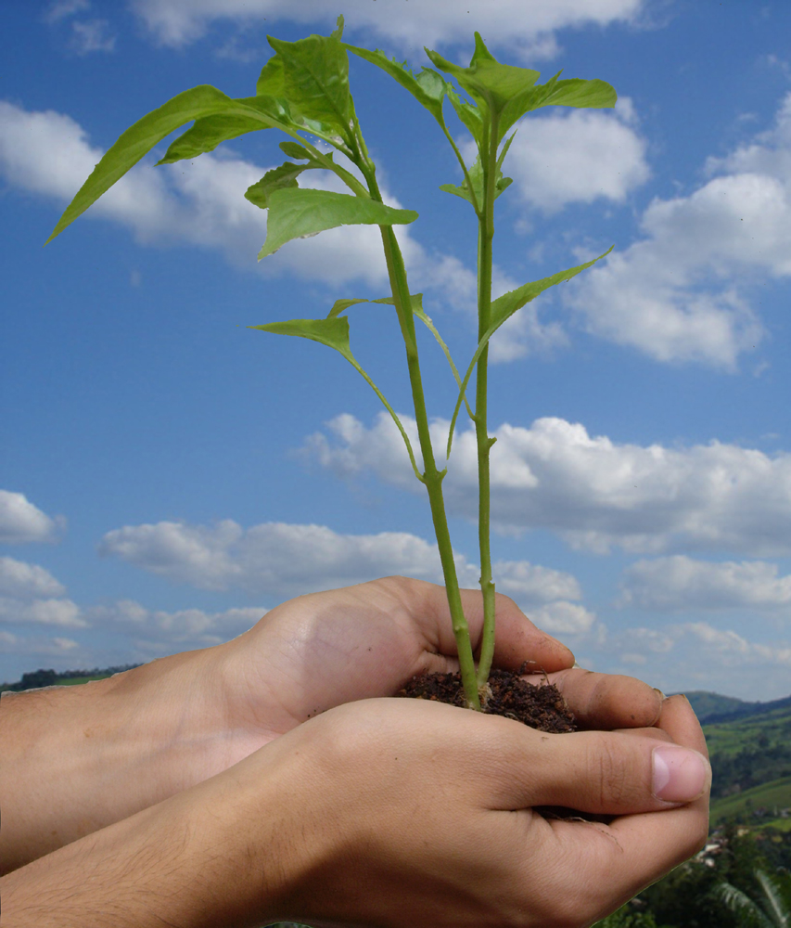
Foundations Seminar--NSCI 1200: Scientific Thinking for Community Resilience
Gary Vieiro
Syllabus
NSCI 1200: Scientific Thinking for Community Resilience
GE Pathway-Environmental Sustainability -The Environmental Sustainability GE pathway provides holistic perspectives on environmental issues by exploring relationships between society /nature through interdisciplinary connections of natural science, social science, humanities, and business.
Course Materials-Text: “On Course”, Skip Downing and Jonathan Brennan, 9th edition.
Participation- Students are evaluated based on the quality of their presence in the classroom. “Quality” here is defined as informed and respectful participation in class.
Final Group Project/ Presentation -Group projects will apply scientific thinking to solving environmental problems affecting our local and global communities. This project entails writing assignments /group presentation. Students complete/revise several assignments that link course concepts to society and nature through interdisciplinary connections of natural/social science, humanities, and business.
STUDENT PROJECT GOALS
Engage and empower students to become active , responsible lifelong learners
Create success in college, in your career and in life.
Dramatically improve outcomes and experiences in life.
Students will develop skill sets addressing topics such as:
Self-motivation, self awareness, and believing in oneself.
Technical career preparation and employment skills.
Active learning and participation with transferable skills.
NOTE: Starting in Fall 2020, all students who start as a freshman at CSUSB will be required a Foundations Seminar course as part of their General Education package.
.
COURSE DESCRIPTION
NSCI 1200: Scientific Thinking for Community Resilience
Exploration of scientific ways of thinking: how scientific knowledge is created and how it is (or could be) communicated to those who use (or could use) it to solve community problems, emphasizing acquisition of academic skills that will be transferrable to other courses. Learning to see the world through the lens of scientific and mathematical analysis, and reflection on how this lens differs from other lenses. Learning how scientific knowledge is created through collaborative processes among those with diverse perspectives. Appreciation of the scientific literature as a professional conversation that expands our understanding of our natural world. Group projects will apply scientific thinking and other approaches to solving environmental problems affecting our local and global communities. Satisfies GE category E.
Wk. | Topics | Activities | Assignments
1-3 | Introduction to Course Journal: e-portfolios Read/summarize article CIL – Tutorial #1 Fixed vs Growth mindset | Think-Pair-Share (1) ongoing Integration of CIL (2) ongoing Journal Writing (6) ongoing “On Course” Student Stories ongoing Spkr: “Library-CIL” | “On Course” Ch. Case Studies , discussion/role play Environmental-Read article/video/ answer discussion questions on BB prior to class. Reflection-Strategies for reading/summarize article Reflection: Group activity on Fixed vs Growth (ppt) Quiz #1
4-6 | Journal: e-portfolios Read/summarize article CIL – Tutorial #1 Use data to support topic | Think-Pair-Share (1) Peer Review (3) Journal Writing (6) Concept map- ”straw” | “On Course” Ch. Case Studies , discussion/role play Discussion/questions on BB Find a popular/scholarly article-summarize Quiz #2
7-9 | Journal: e-portfolios Read/summarize article CIL – Tutorial #2 Use data to support topic | Think-Pair-Share (1) Your carbon footprint (4) Jigsaw (5) Journal Writing (6) Spkr:“Learning Comm. | “On Course” Ch. Case Studies , discussion/role play Discussion/questions on BB 1st draft of Term Paper due. Quiz #3
10-12 | Journal: e-portfolios Read/summarize article CIL – Tutorial #3 | Think-Pair-Share (1) Jigsaw (5) Journal Writing (6) Summary-Students Stories | “On Course” Ch. Case Studies , discussion/role play Discussion/questions on BB 2nd draft of Term Paper due. Quiz #4
13-15 | Journal: e-portfolios Read/summarize article CIL – Tutorial #3 | Think-Pair-Share (1) Journal Writing (6) Spkr:“Career Counselor” | “On Course” Ch. Case Studies , discussion/role play Discussion/questions on BB Term Paper/Presentation due
FS-FLC PROJECT GOALS/ACTIVITIES
Life-Long Learning and Self Development:
Development of teaching strategies and high impact practices.
Be familiar with the required GLO’s.
Share ideas with other faculty members regarding activities
to meet the learning outcomes of the FYS.
Participate in HIP’s designed to integrate with the specific
topic of the course.
Articles /Discussion topics
“Promoting Student Metacognition” – Kimberly D. Tanner
“Measuring Actual Learning vs Feeling of Learning
Dept. of Physics, Chemistry, Harvard University
“How People Learn: Brain, Mind, Experience, and School”
The National Academies of Sciences Engineering Medicine
Summary: Foundations Seminar Learning Community
Preparation to teach NSCI1200 Foundation Seminar.
Development of objectives and practices that support learning and course development with effective teaching strategies.
To build a bridge of effective communication with students
COURSE ACTIVITIES | LO1 | LO2 | LO3 | LO4 | LO5 | LO6
Think-Pair-Share-Students consider a question alone and then discuss in small groups to a final written answer/ Strategies on how to read/summarize. Students strategies-Metacognition Question-Climate Change Myth vs What Science says: “Climate’s changed before”-myth | X | X |  | X | X
2. Integration of CIL- Watch tutorial #1 “Beginning Researchers” from CIL , Pfau library . Assignment-Conduct literature review before /after watching videos and select two articles for your research question using effective keywords. 3 step-Developing a Research Question/Selecting Keywords/Refining your Research Question |  |  | X |  |  | X
Peer Review- A writing assignment focused on (1) developing knowledge of the earth's climate history/global warming and (2) learn to use data to support your climate change topic. Topics-Causes of Earth's Climate/Climate Change Scenarios/ Policy Recommendations and students share their work with peers for constructive feedback /revision of paper. |  | X |  | X | X | X
Your Carbon Footprint-Measure the greenhouse gases that you are responsible for creating. Learn the 5 R’s for reducing your footprint. Discuss in groups and apply ideas in a short paper highlighting 2 opinions from people in your neighborhood or family. |  | X |  | X | X
Jigsaw-Development of your final environmental project. The class is divided into several groups then re-mixed. Each person teaches the rest of the group about their particular assignment. New group puts pieces of puzzle together to form the full picture. |  | X | X | X |  | X
Guided Journal Writing - “On Course” e-portfolios - Read an article about proven success strategies. Through the guided journal entry apply these strategies to your own life. Ex.-Describe a time when you reacted to a learning challenge with a “fixed “/“growth” mindset. | X |  |  | X
STUDENT LEARNING OUTCOMES
LO 1: Metacognition
LO 2: Collaboration
LO 3: Critical Information Literacy
LO 4: Written Communication
LO 5: Thinking Critically
LO 6: Integrative Learning

